Slide 1
SURFACE WATER QUALITY ON CERNA RIVER
Francisc Popescu¹, Milan Trumic², Bogdana Vujic³, Nada Strbac², Adrian Eugen Cioabla¹, Vukosav Antonijevic⁴, Carmen Radescu⁵, Gavrila Trif-Tordai¹
¹University Politehnica Timisoara, Faculty of Mechanical Engineering, Timisoara, Romania
²University of Belgrade, Technical Faculty in Bor, Bor, Serbia
³University of NoviSad, Technical Faculty “Mihajlo Pupin” Zrenjanin, Zrenjanin, Serbia
⁴NGO “Village” Movement for developing Estern Serbia, Bor, Serbia
⁵ProMehedinti Association, Drobeta-Turnu Severin, Romania
aeps.upt.ro

Slide 2
Research framework
This study is part of a bigger research conducted in the frame of an INTERREG IPA-CBC Romania-Serbia programme project, RORS-462, with several main targets:
Assessment of surface water quality on:
Danube river (from Bazias/Banatska Palanka down to Iron Gate II / Djerdap II)
Danube's main tributaries Pek, Berzasca, Cerna, Nera, Porecka rivers
Carska-Bara and Balta Nera special nature reserve’s
Assessing the influence of copper mining activities in Majdanpek on Danube river water quality.
Raising the awareness of young generations on both sides of the border on the immediate need to protect the region remarkable natural heritage!
Development the research infrastructure of University Politehnica Timisoara and Technical Faculty in Bor.
www.aeps.upt.ro

Slide 3
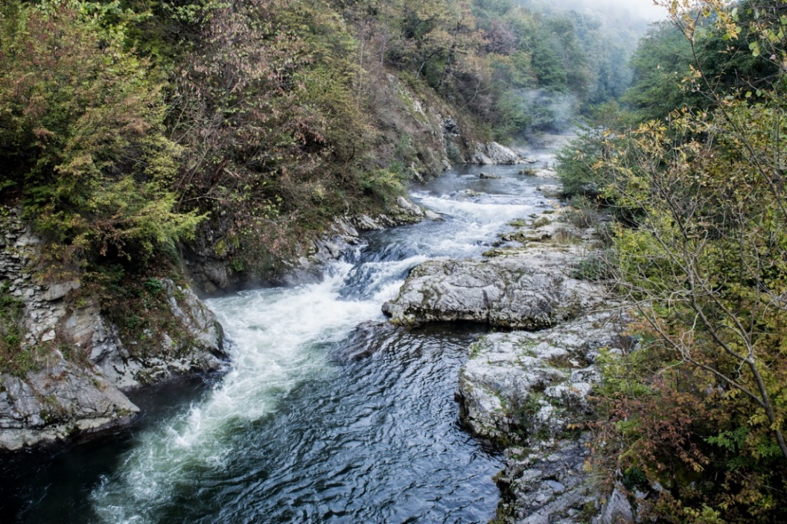
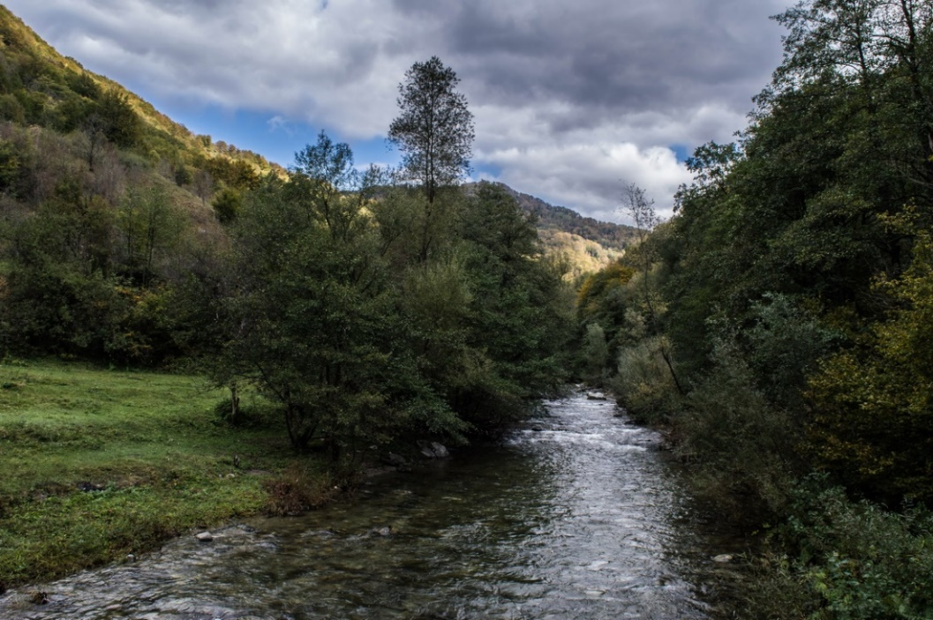
Cerna river
Cerna River flows over 79 km thru The Domogled-Valea Cernei National Park is a protected area (national park category II IUCN) situated in Romania, on the administrative territory of counties Caras-Severin, Gorj and Mehedinti.
The National Park stretches across over the Cerna Mountains and the Godeanu Mountains on the right side, and over the Valcan Mountains and the Medinti Mountains on the left side, all part of Southern Carpathians.

Slide 4
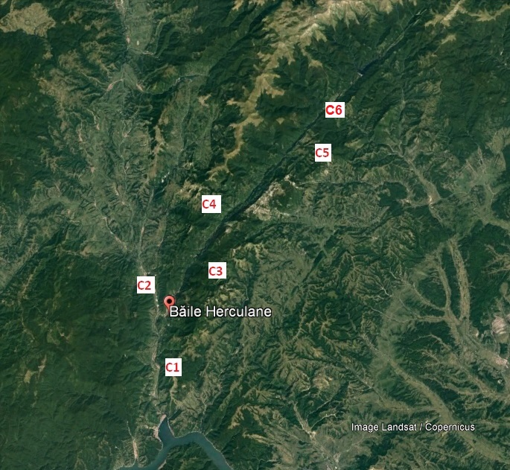
Sampling sites, samples preservation and equipment’s
The in-situ analysis (for pH, temp, total hardness and dissolved oxygen) were performed on site.
All samples were preserved in-situ for laboratory analysis with acids:
HNO₃ (nitric acid) for metal concentration analysis on ZEEnit 700P,
H₃PO₄ (phosphoric acid) for Total Nitrogen analysis on Analytik Jena Multi N/C 3100 and
H₂SO₄ (sulfuric acid) for Chemical Oxygen Demand analysis on Velp Eco6 and ammonia, phosphor, nitrite, nitrate, phosphate, a.o. on Analytik Jena Specord 250plus.
All samples taken were analyzed in-situ or at the end of the sampling day.

Slide 5
Limit values of pollutants in surface waters, Romania
Parameter | Unit | Limit values
 |  | I class | II class | III class | IV class | V class
pH | - | 6.5 – 8.5
Conductivity | µS/cm | -
Dissolved oxygen (DO) | mgO₂/l | 9 | 7 | 5 | 4 | < 4
Biochemical oxygen demand (BOD – CBO5) | mgO₂/l | 3 | 5 | 7 | 20 | > 20
Chemical oxygen demand (COD – CCO-Cr) | mgO₂/l | 10 | 25 | 50 | 125 | > 125
Ammonia (NH₄⁻) | mg/l | 0.01 | 0.3 | 0.06 | 0.3 | > 0.3
Nitrates (NO₃⁻) | mg/l | 1 | 3 | 5.6 | 11.2 | > 11.2
Nitrites (NO₂⁻) | mg/l | 0,01 | 0,03 | 0,12 | 0,3 | >0,3
Total Nitrogen (TN) | mg/l | 1.5 | 7 | 12 | 16 | > 16
Orto phosphate (P-PO₄³⁻) | mg/l | 0.1 | 0.2 | 0.4 | 0.9 | > 0.9
Sulphates (SO₄²⁻) | mg/l | 60 | 120 | 250 | 300 | >300
Chloride (Cl⁻) | mg/l | 25 | 50 | 250 | 300 | > 300
Sodium (Na+) | mg/l | 25 | 50 | 100 | 200 | > 200
Calcium (Ca2+) | mg/l | 50 | 100 | 200 | 300 | > 300
Mercury (Hg) | µg/l | 0.1 | 0.3 | 0.5 | 1 | > 1
Arsenic (As₃⁺) | µg/l | 10 | 20 | 50 | 100 | > 100
Lead (Pb) | µg/l | 5 | 10 | 25 | 50 | > 50
Zinc (Zn₂⁺) | µg/l | 100 | 200 | 500 | 1000 | > 1000
Cadmium (Cd) | µg/l | 0.5 | 1 | 2 | 5 | > 5
Manganese (Mn - total) | mg/l | 0.05 | 0.1 | 0.3 | 1 | > 1
Iron (Fe – total) | mg/l | 0.3 | 0.5 | 1.0 | 2 | > 2

Slide 6
Results
Parameter | Unit | Measured values – 19th October 2020 |  |  |  |  |  | Eco state
 |  | C1 | C2 | C3 | C4 | C5 | C6
pH | - | 7.34 | 7.33 | 7.38 | 7.42 | 7.38 | 7.31 | -
Conductivity | µS/cm | 372 | 394 | 388 | 389 | 378 | 377 | -
 |  | Oxygen concentration
Dissolved oxygen (DO) | mgO₂/l | 5.7 | 6.8 | 9.9 | 10.1 | 10.5 | 10.2 | Ist – IInd
Biochemical oxygen demand (BOD – CBO5) | mgO₂/l | 7.4 | 6.5 | 3.1 | 2.3 | 2.2 | 2.2 | Ist – IIIrd
Chemical oxygen demand (COD – CCO-Cr) | mgO₂/l | 18.1 | 16.5 | 8.4 | 7.2 | 6.9 | 6.9 | Ist – IInd
 |  | Nutrients and general ions concentrations
Sodium (Na+) | mg/l | 3.6 | 3.2 | 3.2 | 3.5 | 3.4 | 3.4 | Ist
Calcium (Ca2+) | mg/l | 41.2 | 38.9 | 39.1 | 29.8 | 33.4 | 27.9 | Ist
Ammonia (NH₄⁻) | mg/l | 0.74 | 0.65 | 0.11 | 0.09 | 0.07 | 0.09 | Ist – IInd
Nitrates (NO₃⁻) | mg/l | 0.34 | 0.33 | 0.22 | 0.14 | 0.12 | 0.12 | Ist
Nitrites (NO₂⁻) | mg/l | 0.028 | 0.028 | 0.017 | 0.012 | 0.014 | 0.014 | Ist
Orto phosphate (P-PO₄³⁻) | mg/l | 0.09 | 0.08 | 0.06 | 0.06 | 0.06 | 0.05 | Ist
Sulphates (SO₄²⁻) | mg/l | 37.2 | 40.5 | 34.1 | 22.4 | 5.4 | 4.8 | Ist
Chloride (Cl⁻) | mg/l | 0.6 | 0.6 | 0.3 | 0.2 | 0.2 | 0.2 | Ist
Total Nitrogen (TN) | mg/l | 0.89 | 0.77 | 0.54 | 0.52 | 0.49 | 0.51 | Ist
 |  | Heavy Metals concentrations
Mercury (Hg) | µg/l | 0.030 | 0.026 | 0.015 | 0.011 | 0.014 | 0.011 | Ist
Arsenic (As₃⁺) | µg/l | 0.088 | 0.087 | 0.087 | 0.088 | 0.086 | 0.079 | Ist
Lead (Pb) | µg/l | 0.054 | 0.016 | 0.018 | 0.014 | 0.016 | 0.017 | Ist
Zinc (Zn₂⁺) | µg/l | 12.1 | 12.8 | 10.1 | 8.9 | 8.8 | 7.5 | Ist
Cadmium (Cd) | µg/l | 0.007 | 0.005 | 0.006 | 0.005 | 0.005 | 0.006 | Ist
Manganese (Mn - total) | mg/l | 0.057 | 0.061 | 0.055 | 0.049 | 0.051 | 0.032 | IInd
Iron (Fe – total) | mg/l | 0.462 | 0.511 | 0.499 | 0.397 | 0.421 | 0.394 | IInd

Slide 7
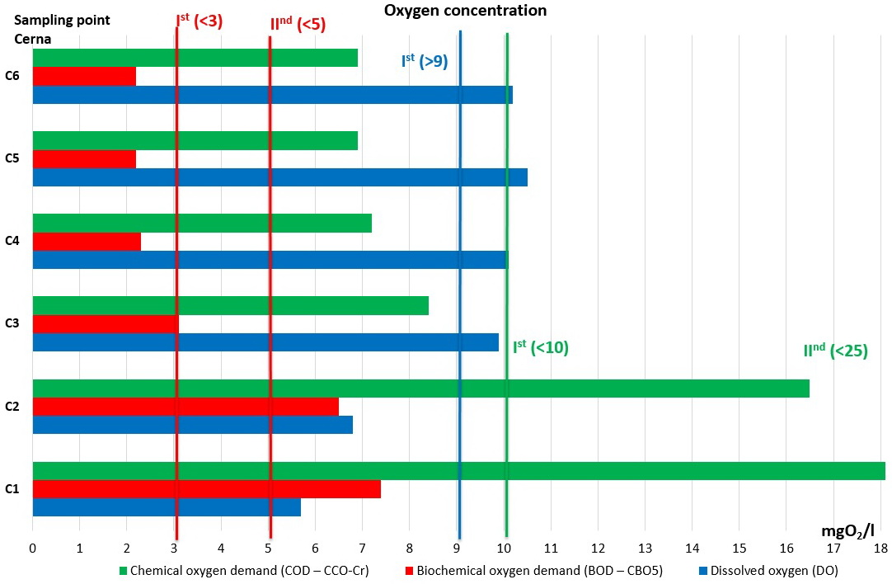
Results

Slide 8
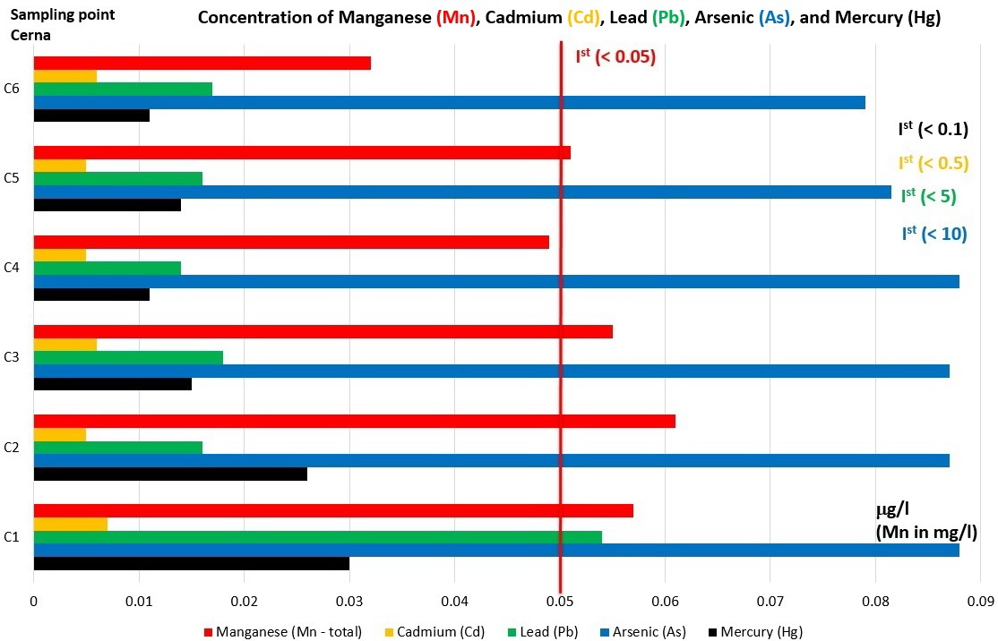
Results

Slide 9
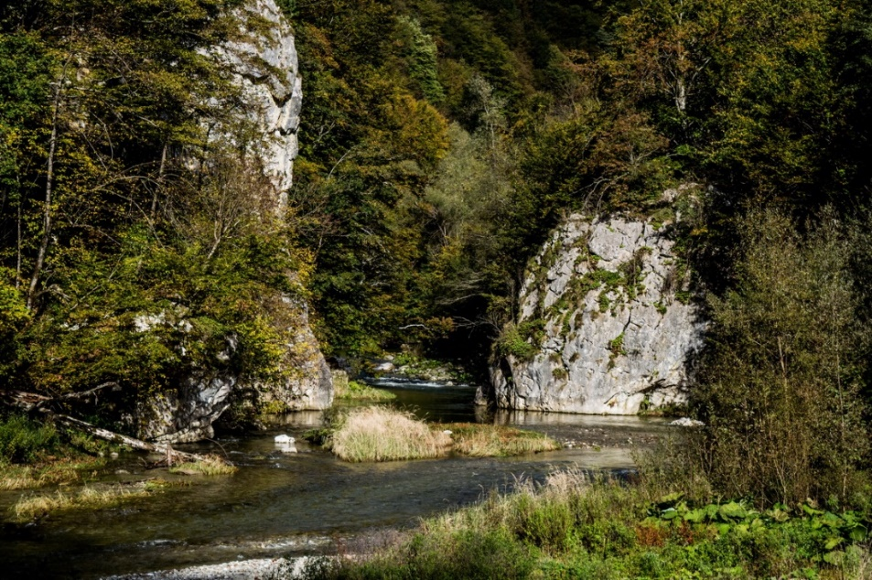
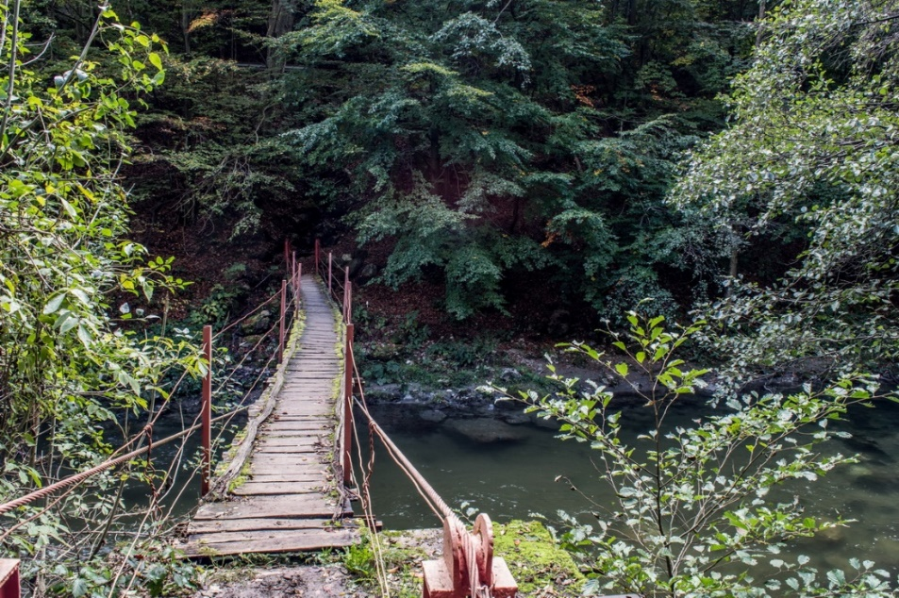
Conclusion
In terms of water quality Cerna River can be considered a “text book” river.
In its upper (wilder) part all analyzed parameters (dissolved oxygen, biological oxygen demand, chemical oxygen demand, nitrites, nitrates, ammonia, phosphates, and total nitrogen) were all in Ist class, HIGH water quality.
However, after Cerna passes first human settlements, Baile Herculane, Toplita and gets tributary from Belareca river, on its last ~20 km the water quality decreases dramatically, “transforming” itself into GOOD/MODERRATE water quality river.

Slide 10
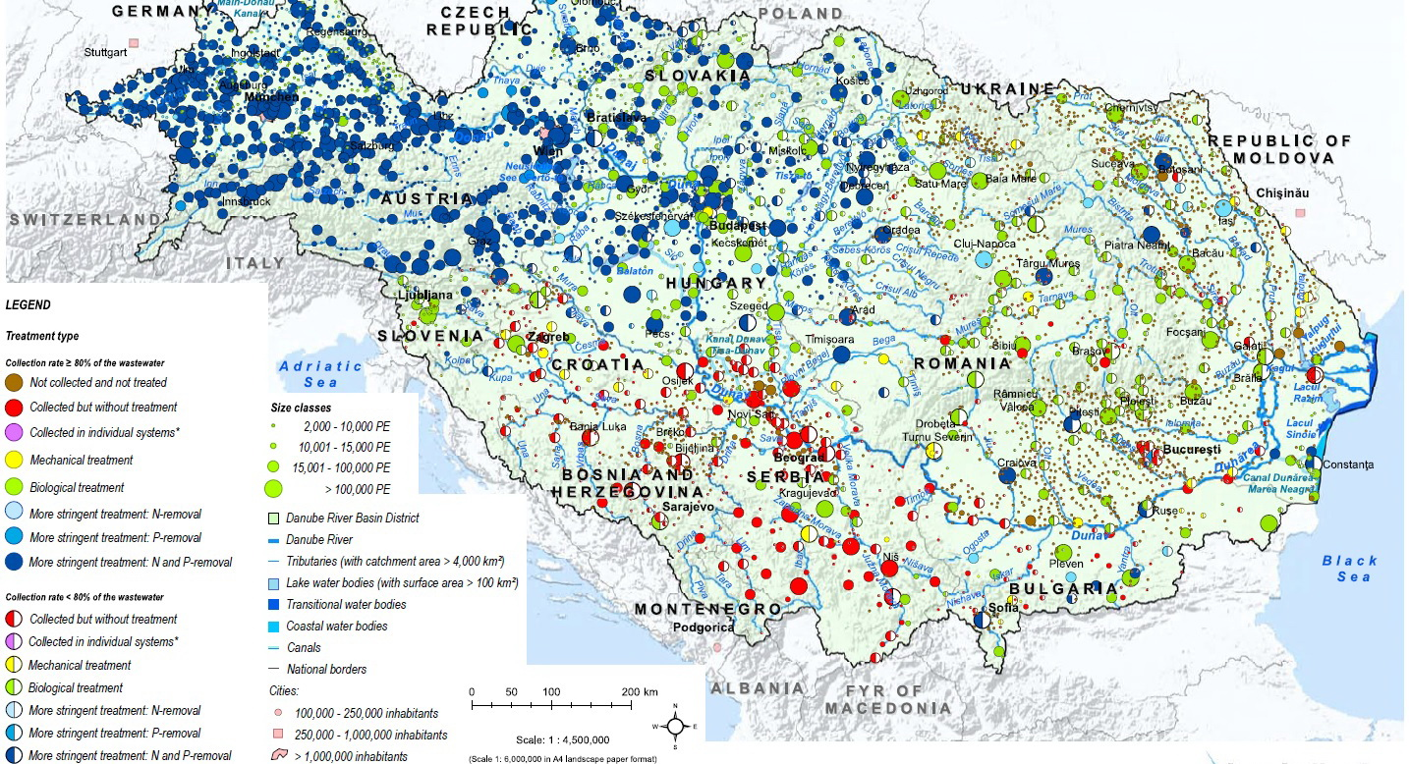
Urban waste water treatment in Europe, reference situation 2015
European Environmental Agency, 2017, https://www.eea.europa.eu/data-and-maps/indicators/urban-waste-water-treatment/

Slide 11
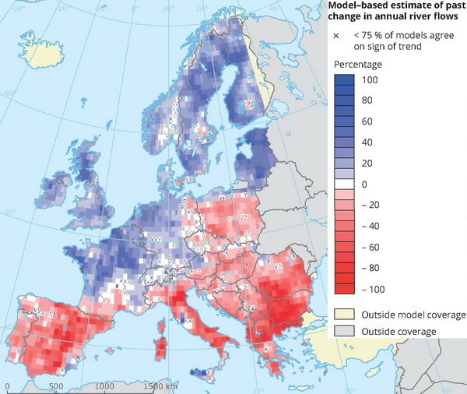
Model-based estimate of past change in annual river flows
Stahl K., Tallaksen L. M., Hannaford J., van Lanen H. A. J., 2012, Filling the white space on maps of European runoff trends: estimates from a multi-model ensemble, Hydrology and Earth System Sciences, Vol. 16(7), pp.2035–2047 (DOI: 10.5194/hess-16-2035-2012)

Slide 12
Aknowledgment.
This research was conducted in the frame of AEPS project, “Academic Environmental Protection Studies on surface water quality in significant cross-border nature reservations Djerdap / Iron Gate national park and Carska Bara special nature reserve, with population awareness raising workshops”, financed thru INTERREG IPA-CBC Romania-Serbia programme, project RORS-462, www.aeps.upt.ro

